Slide 1
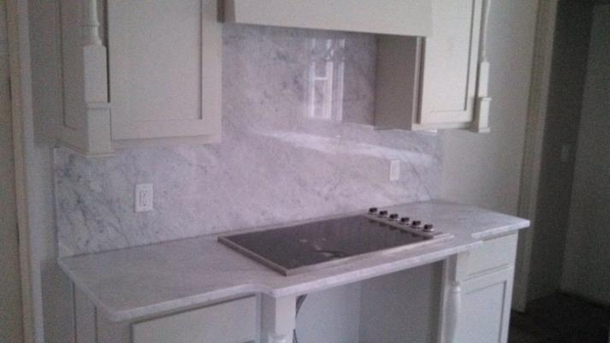
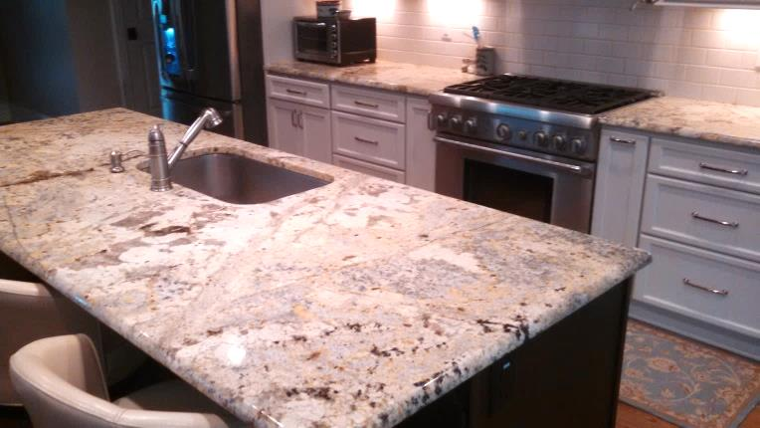
GRANITE · MARBLE · SOLID SURFACES · QUARTZ
Welcome to Carolina Countertops. We are a full service countertop company providing quality products and customer service at affordable prices.
A kitchen is the showpiece of the house, and can sell a house!
Granite prices have dropped significantly in the past years, making stone countertops an affordable way to make a big impact on perspective buyers.
Please contact Carolina Countertops for a free estimate!
919-475-5966
www.carolinacountertopsinc.com
CABINETS · VANITIES · FIREPLACES · SHOWERS/BATHS · OUTDOOR SPACES

